Slide 1


Workshop on Git & Github
By : Mr Youssef Lachhab

Slide 2
Plan
Installing and configuring git
Versioning your work locally
Versioning your work on github
Work together on a repository
create the branches
Conflict management

Slide 3

What are you doing every day ?
We create and edit document (texts,images,etc.

Slide 4
Our routine
Create a file
Save it
Edit it
Save it again
Go to 1

Slide 5
Our routine
Delete some code
Add another code
File creation
Add some code
Time

Slide 6
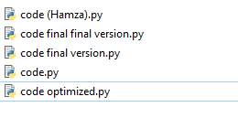
When we decide to organize your code

Slide 7



there's a problem
Delete some code
Add another code
File creation
Add some code
time
Abdellah
Mohammed
Jalal
Mohammed

Slide 8
There's a problem
time
When was the modification ?
What's the change ?
Why it was changed ?
Who did the modification ?

Slide 9
What is the solution ?

Slide 10

Git : Is free and open source software for distributed version control: tracking changes in any set of files, usually used for coordinating work among programmers collaboratively developing source code during software development. Its goals include speed, data integrity, and support for distributed, non-linear workflows (thousands of parallel branches running on different systems)
Notes:
Hna ngoulou => La partie 1 ghadi tkoun dial versioning ou kifach nste3moul git f un projet li khedam fih ghi rassek & then the second part the collaboration ….

Slide 11
Download & install git at http://git-scm.com
https://www.youtube.com/watch?v=nbFwejIsHlY

Slide 12
Basic concepts

Slide 13




Repository
Directory 1
Directory 2
file.txt
file.py
image.jpg

Slide 14
Configuring git
$ git config --global user.name “youssef lachhab”
$ git config --global user.email “youssef.lachhab.2020@gmail.com"
$ git config - -global --list

Slide 15
Repository
$ mkdir new_project
$ cd new_project
$ git init
git init : it is used to make an existing project as a Git project.
Notes:
This command creates an empty Git repository - basically a .git directory with subdirectories for objects, refs/heads, refs/tags, and template files. An initial HEAD file that references the HEAD of the master branch is also created.
If the $GIT_DIR environment variable is set then it specifies a path to use instead of ./.git for the base of the repository.
If the object storage directory is specified via the $GIT_OBJECT_DIRECTORY environment variable then the sha1 directories are created underneath - otherwise the default $GIT_DIR/objects directory is used.
Running git init in an existing repository is safe. It will not overwrite things that are already there. The primary reason for rerunning git init is to pick up newly added templates (or to move the repository to another place if --separate-git-dir is given).

Slide 16

Commit

Slide 17

Commit
Delete some code
Add some code
Add another code
File creation
time
Abdellah
Mohammed
Jalal
Mohammed

Slide 18
Git Add
$ git add <file_1_wich_has_been_modified
$ git add <new_file>
git add :The git add command adds new or changed files in your working directory to the Git staging area. the files that you want enter in .Commit

Slide 19
Commit
$ git add <file_1_wich_has_been_modified
$ git add <new_file>
$ git commit -m “A meaningful message about this change”
https://dev.to/jacobherrington/how-to-write-useful-commit-messages-my-commit-message-template-20n9

Slide 20
Status
$ git status
git status :Displays paths that have differences between the index file and the current HEAD commit, paths that have differences between the working tree and the index file, and paths in the working tree that are not tracked by Git .
Notes:
Displays paths that have differences between the index file and the current HEAD commit, paths that have differences between the working tree and the index file, and paths in the working tree that are not tracked by Git (and are not ignored by gitignore[5]). The first are what you would commit by running git commit; the second and third are what you could commit by running git add before running git commit.

Slide 21
log
$ git log
git log : commits list
git log – n2 : List the last two commits

Slide 22
log
$ git show
$ git checkout
git show idcommit : to see a specific commit
git checkout idcommit :To return back to a old version

Slide 23
Branch
Main branch
HEAD of main
Head :A reference to the latest Commit.
Main :It is the primary and main branch
Notes:
Head = A reference to the most recent commit
(in most cases – not always true!) remote repository isn’t updated for example .
Master = The main branch in your project
• Doesn’t have to be called master, but almost
always is!

Slide 24
Branch
Main
my-feature
$ git branch my-feature
(One Feature = One Branch )
Git branch :Create a new branch called ＜my-feature＞. This does not check out the new branch. always you are in Branch Main

Slide 25
Branch
Main
my-feature
$ git checkout my-feature
$ git branch
Git checkout : Move to a new branch .
Git branch : Return all branches of our project

Slide 26
Log
$ git log
Git log: Shows the commit logs.
$ git log my-feature
Git log: Shows the commit logs that exist in the branch (my-feature ).

Slide 27
Diff
$ git diff
$ git diff <a_specific_file_or_folder>
Main
my-feature
$ git diff main my-feature
Git diff :Show changes between the working tree and the index or a tree, changes between the index and a tree, changes between two trees, changes between two blob objects, or changes between two files on disk.
Notes:
Show changes between the working tree and the index or a tree, changes between the index and a tree, changes between two trees, changes between two blob objects, or changes between two files on disk.
git log :
Shows the commit logs.
The command takes options applicable to the git rev-list command to control what is shown and how, and options applicable to the git diff-* commands to control how the changes each commit introduces are shown.

Slide 28
Merge
Master
my-feature
$ git checkout master
$ git merge my-feature
Git merge:Merge the branch named my-feature with the actual branch

Slide 29
Merge
Main
my-feature
$ git checkout main
$ git diff main..my-feature
$ git merge my-feature
Move to branch main
Show changes in my-feature compared to main
Merge my-feature with the current branch (in this example main )

Slide 30
Delete a branch
Master
my-feature
$ git branch --delete my-feature

Slide 31


Local Repository
Remote Repository
Your computer
Remote server
Notes:
to be made in the begenning.

Slide 32




Slide 33
Let’s create a remote repo !
Go to Github, create a repo: http://github.com/new
$ git remote add origin https://github.com/<user>/<project>.git
Git remote add:it will know (serveur remote) our project , but the code still in local

Slide 34
Push
Share your code with others
$ git push <remote> <branch>
Pull
Bring back the others code
$ git pull <remote> <branch>
Notes:
The process of downloading
commits that don’t exist on your
machine from a remote repository
is called pulling changes
• The process of adding your local
changes to the remote repository
is called pushing changes

Slide 35
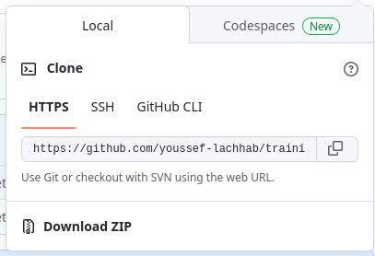
Clone
$ git clone https://github.com/<user>/<project>.git
Git clone: Clone Remote Repo in the local

Slide 36
Scenario diagram
He don't have the project
clone
Remote Repository
Remote server

Slide 37
He don't have the project
Scenario diagram
clone
Remote Repository
He has the repo ,he want to bring back the changes
pull
Remote server

Slide 38
Scenario diagram
He don't have the project
clone
Remote Repository
He has the repo ,he wants to bring back the changes
pull
He has the repo,he wants to share the changes that he made
push
Remote server

Slide 39
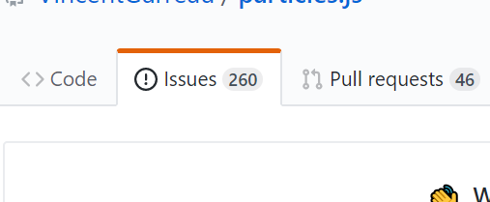
Issues
Issues:Use GitHub Issues to track ideas, feedback, tasks, or bugs for work on GitHub
Any one can open an issue
issue i can Assign to a person
When the problem solve,we close it

Slide 40
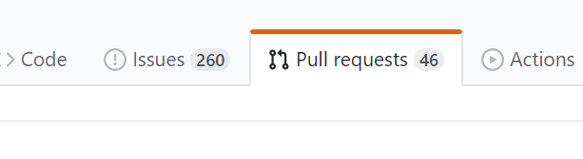
Pull-request
Pull-request :
Merge request between one branch of another
generally in relation about an issue

Slide 41
Blame
git-blame - Show what revision and author last modified each line of a file
git blame file.html display the modifs line by line
git blame -L 10 20 file.html display the modifs in line 10 and 20

Slide 42
References
https://git-scm.com
al fihriya academy
www.w3schools.com

